Slide 1

LAPD CRIME ANALYSIS PROJECT
BDAT-1011
DATA ANALYTICS PROJECT
FINAL PRESENTATION
Prepared by : KAAP Consultancy Ashima Ashima | Priyashaa Sharma
Kriti Komati | Anujeet Siwach

Slide 2
CONTENTS
About LAPD
Project Summary
Meet Our Team
Project Status
Project Management practices and procedures
Requirement Phase
Design Phase
Development Phase
Project Cost

Slide 3
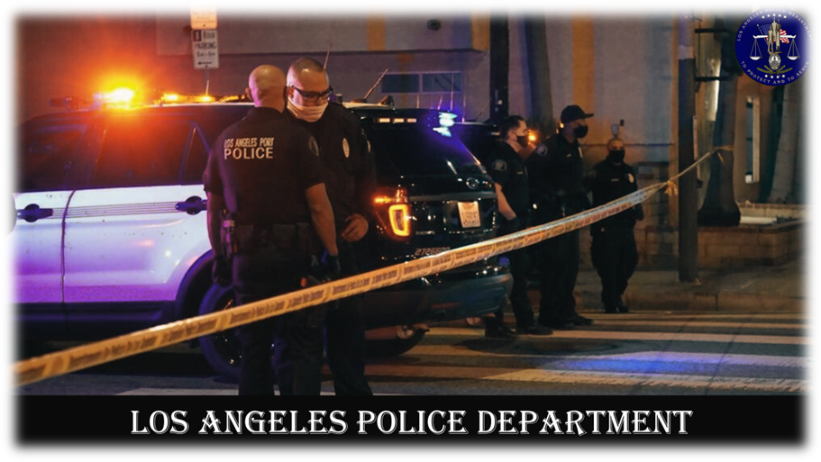
ABOUT LAPD
The Los Angeles Police Department (LAPD) stands as a renowned law enforcement agency entrusted with upholding public safety and enforcing the law across the expansive urban landscape of Los Angeles, California. As a stalwart guardian of the varied communities and districts that make up the city, LAPD remains dedicated to pursuing inventive strategies for the proactive and effective management of crime.

Slide 4

PROJECT summary
In the realm of crime prevention, LAPD recognizes the power of data-driven solutions. Our commitment involves employing machine learning and geospatial analysis to refine crime prediction and hotspot identification, ultimately reinforcing community safety and trust. This proposal outlines a comprehensive strategy to leverage advanced technology for the benefit of Los Angeles.
Key Objectives:
1. Primary Objective: Develop a machine learning model that accurately predicts crime classifications based on historical data, including date, time, location, and crime code.
2. Secondary Objective: Utilize geospatial analysis techniques to pinpoint crime hotspots within the city of Los Angeles.

Slide 5





MEET
OUR
TEAM
ASHIMA ASHIMA
PROJECT LEAD
PRIYASHAA SHARMA
BUSINESS ANALYST
ANUJEET SIWACH
BUSINESS ANALYST
KRITI KOMATI
TECHNICAL LEAD

Slide 6




PROJECT STATUS : ON TRACK
Client Acceptance of Project Charter Phase
Handover of the Deliverables Phase
Design Phase
Release Phase
6 September 2023
1 November 2023
29 November 2023
13 December 2023
9 August 2023
27 September 2023
15 November 2023
6 December 2023
Project Close-Out Phase
Requirements
Phase
Development Phase & Testing Phase
Client Presentation

Slide 7

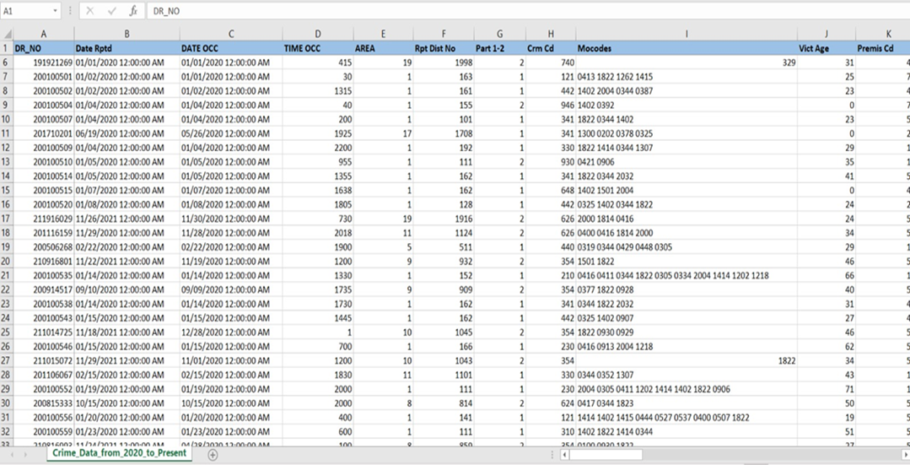
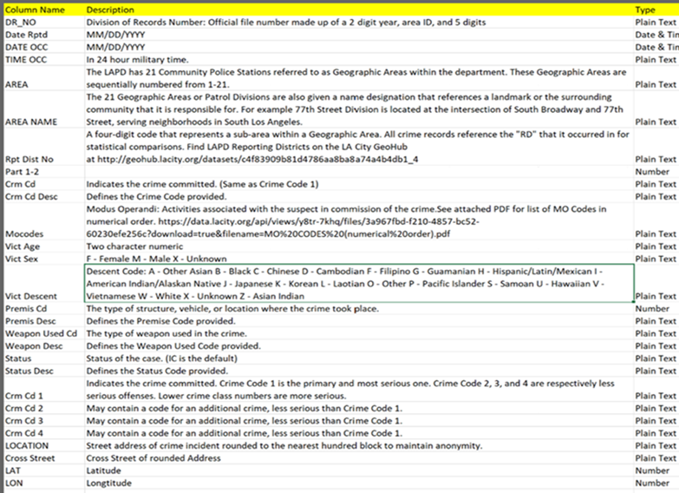
REQUIREMENT PHASE
This dataset comprises records of criminal incidents within the City of Los Angeles dating back to the year 2020.
It contains a total of 788,768 data records, encompassing 10 qualitative variables and 18 quantitative variables.
A comprehensive Data Dictionary for a deep understanding of our dataset. This valuable resource offers detailed descriptions of each data attribute, making it easier to interpret and analyze the data.

Slide 8

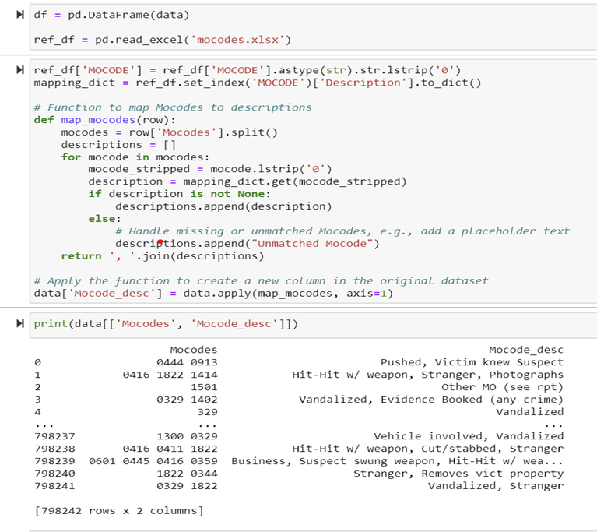
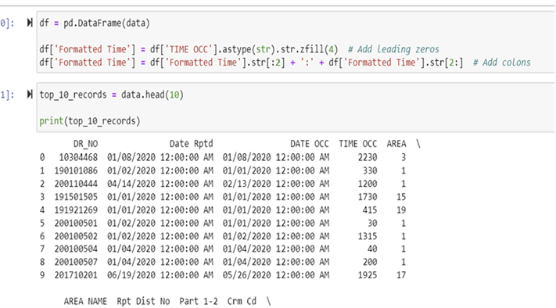
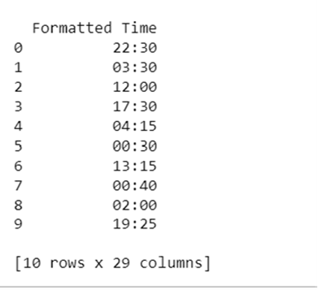
DESIGN PHASE - DATA CLEANING
Ethnic descent descriptions is assigned based on a predefined dictionary to the 'Vict Descent' column, creating a new 'Vict Description' column with descriptive values.
A new column 'Formatted Time’ is created by converting the 'TIME OCC' column to a string, adding leading zeros and colons to represent time in HH:MM format, and then displays the top 10 records from the dataset.

Slide 9
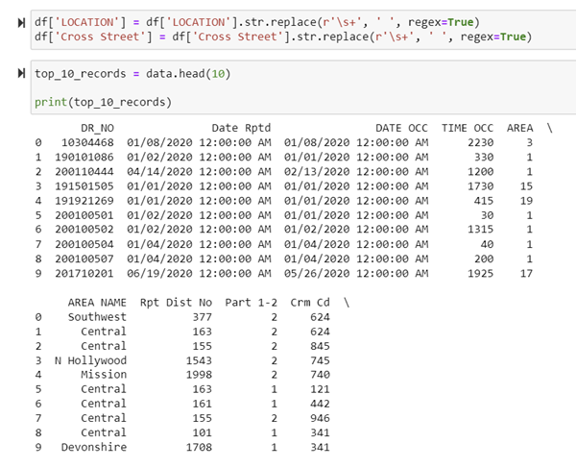
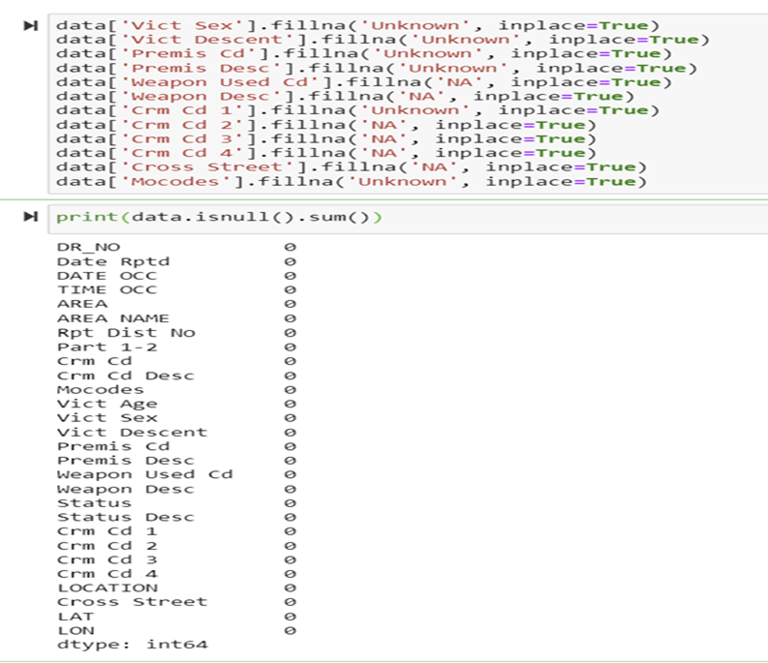
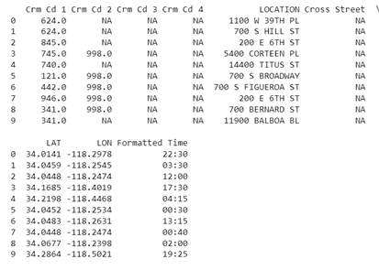
DESIGN PHASE - DATA CLEANING
Extra whitespace within the 'LOCATION' and 'Cross Street' columns is removed by replacing consecutive spaces with a single space using regular expressions.
Missing values in specific columns replaced with appropriate placeholders like 'Unknown' or 'NA' for data completeness and analysis.

Slide 10
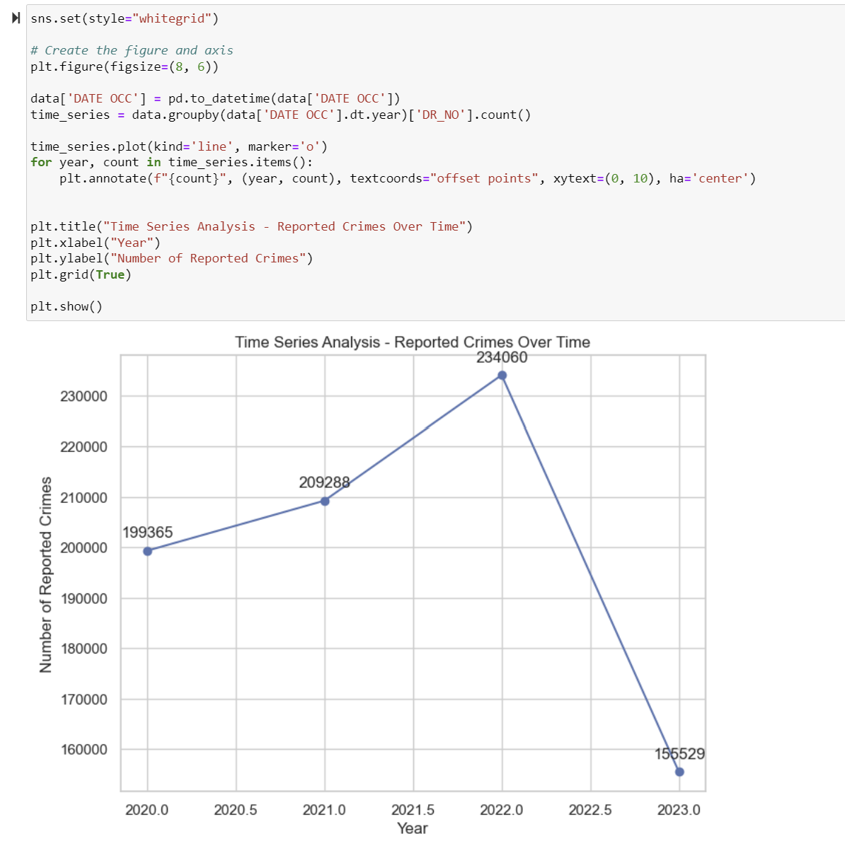
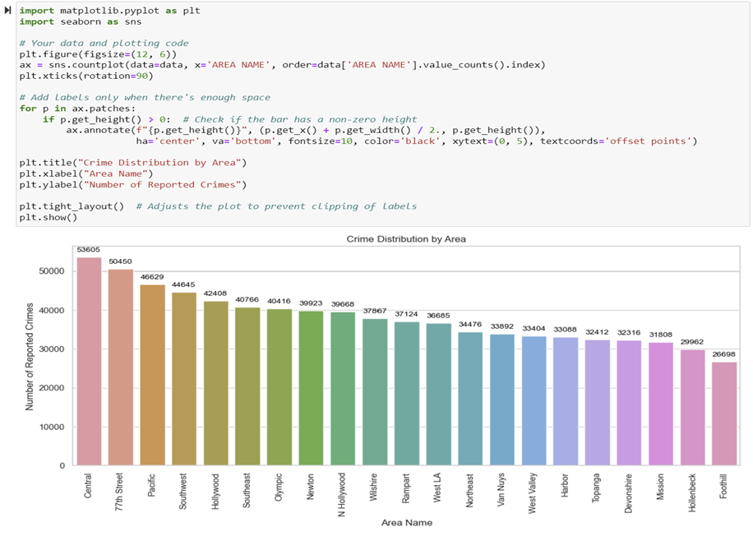
DESIGN PHASE - DATA ANALYSIS
A time series line plot showing the number of reported crimes over different years, with annotations indicating the crime count for each year.
A count plot to visualize the distribution of reported crimes by area, with annotations displaying the count on top of each bar, and adjusts the plot layout for better visualization.

Slide 11
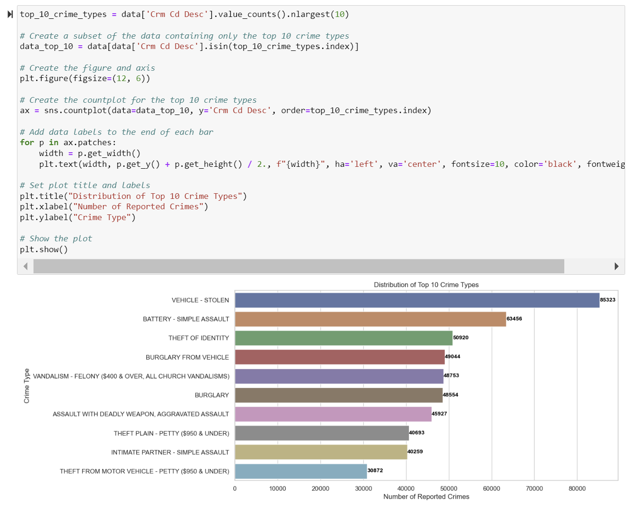
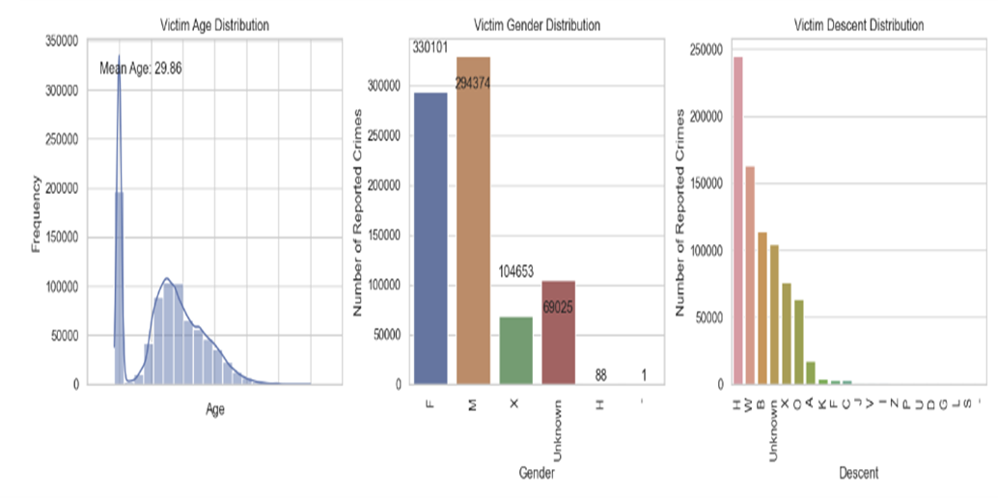
DESIGN PHASE - DATA ANALYSIS
A horizontal bar chart displaying the distribution of the top 10 crime types, with labeled bars showing the number of reported crimes for each type.
Histogram of victim ages showing their distribution, a bar chart displaying the distribution of victim genders, and another bar chart showcasing the distribution of victim descents in reported crimes

Slide 12
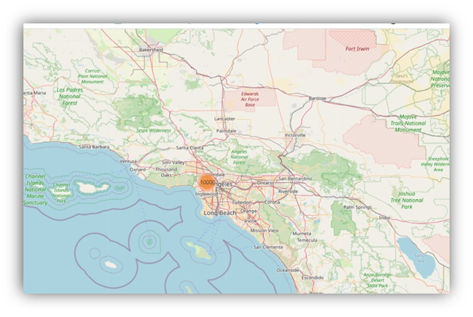
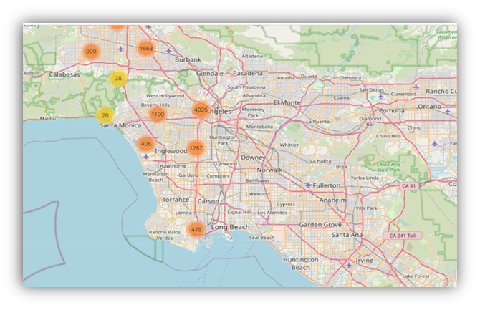
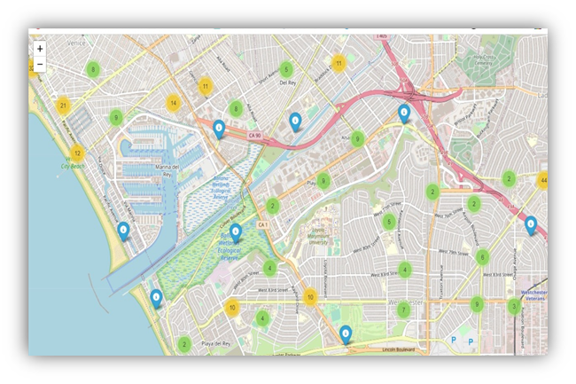

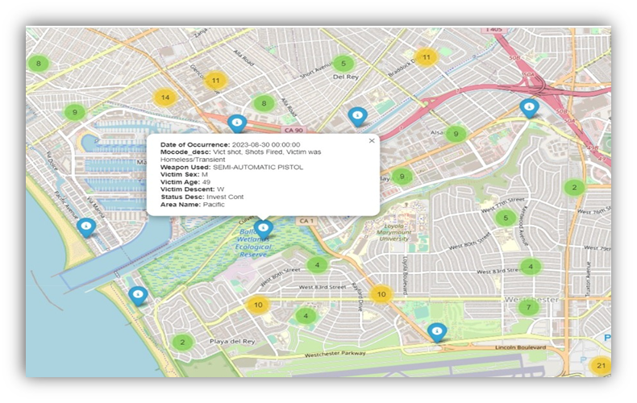
DESIGN PHASE - DATA ANALYSIS
Visualized 10,000 recent 'IC' status crime incidents in Los Angeles on an interactive map with marker clusters, showcasing date, MO code, weapon, and victim details.

Slide 13
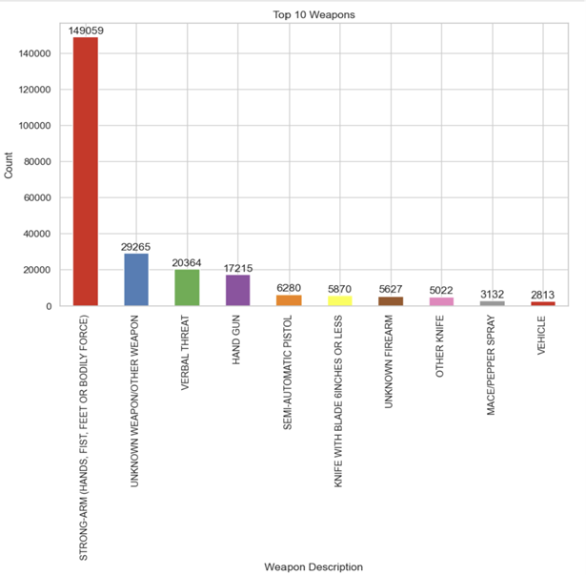
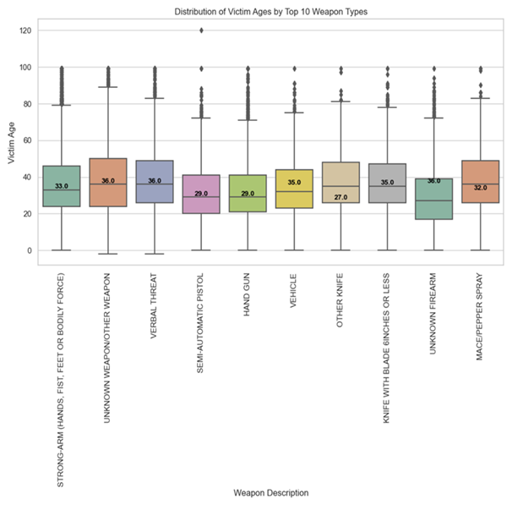
DESIGN PHASE - Data Analysis
The bar chart displays the top 10 weapon descriptions by frequency in the dataset.
This visualization illustrates how victim ages are distributed among the top 10 frequently used weapon types in crimes.

Slide 14
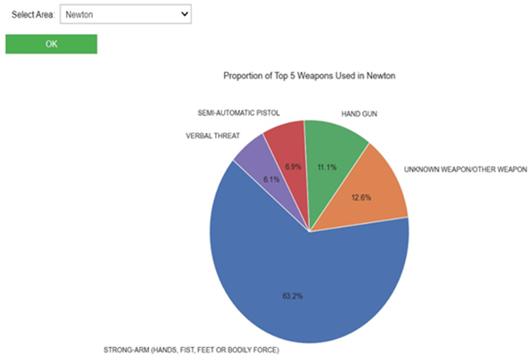
DESIGN PHASE - Data Analysis
The output is an interactive widget of pie chart presents the proportions of the top 5 weapon types used in crimes within a selected geographical area.

Slide 15

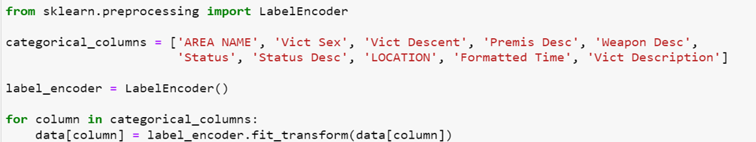
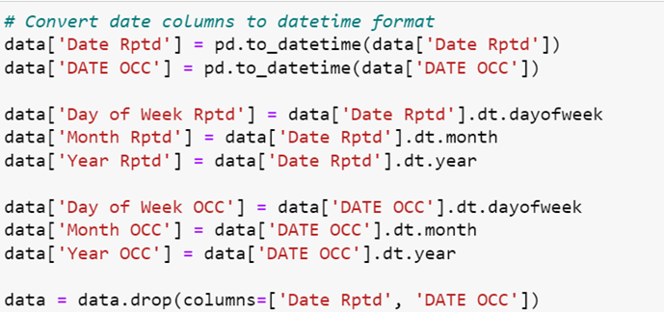
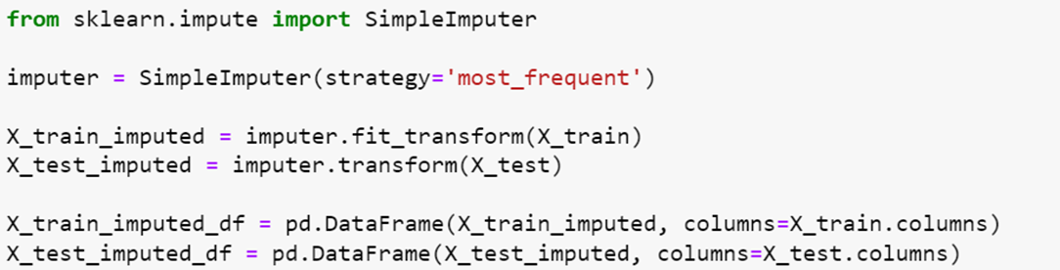
DEVELOPMENT PHASE - PREPARATION PHASE
Removing Columns Unwanted
Encoding categorical values with numerical values for each category
Separating Date into Individual Columns
Filling missing values with most frequent using simple Imputer

Slide 16
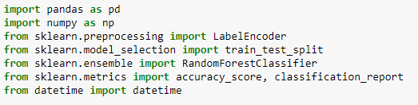
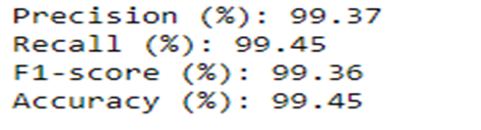
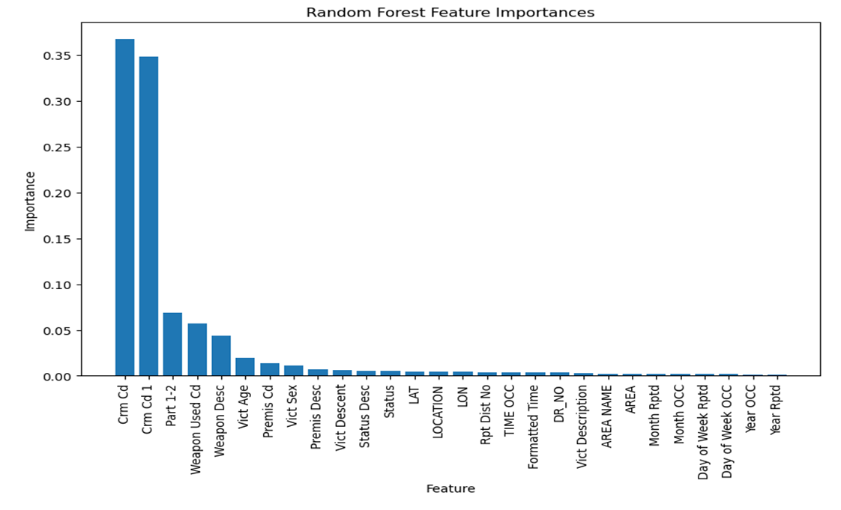
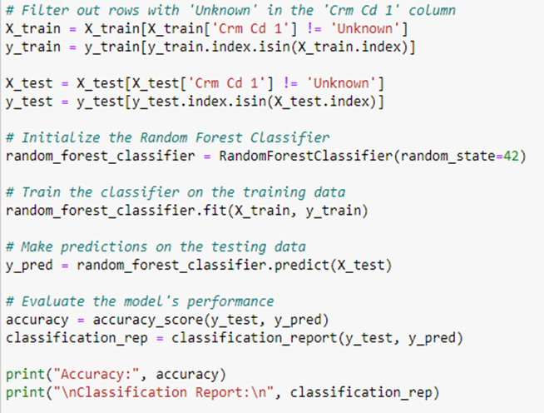
RANDOM FOREST
Imported Libraries
Test : Train = 30:70
Random Forest Classifier with Data Preprocessing

Slide 17
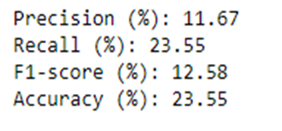
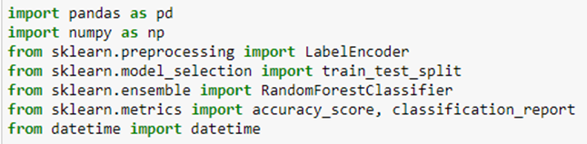
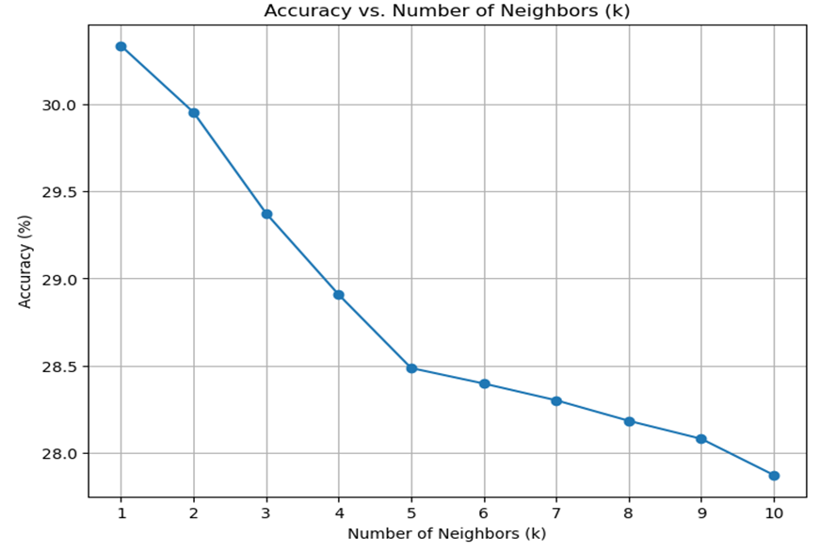
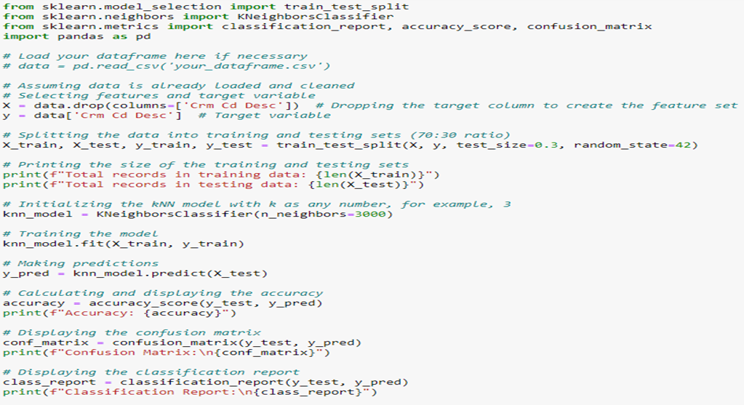
K-Nearest neighbours
Imported Libraries
Test : Train = 30 : 70
Optimal K-Value Selection for KNN Classifier
KNN Classifier for Crime Data

Slide 18
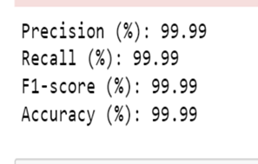
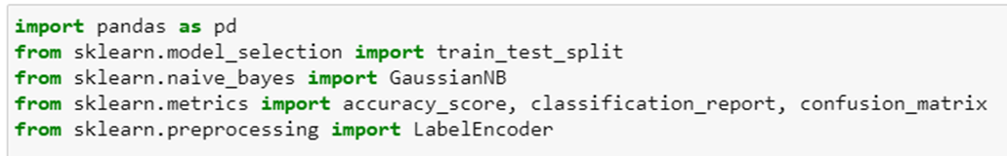
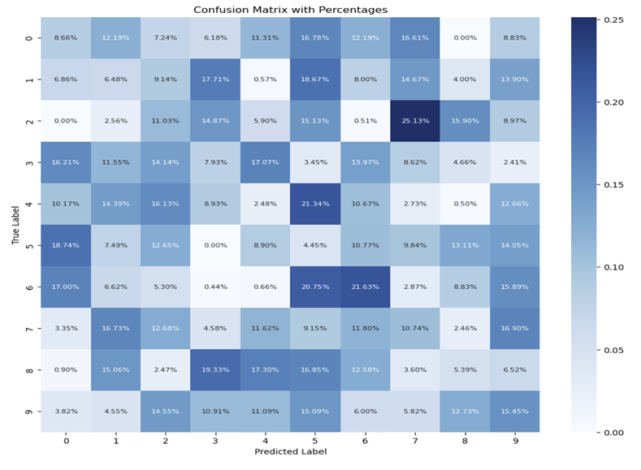
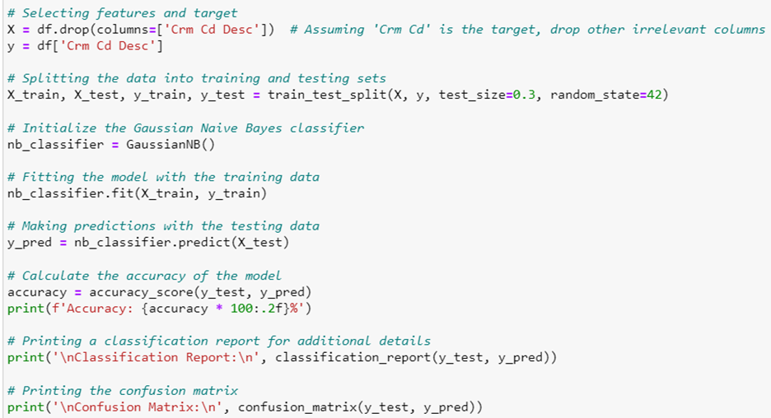
NAÏVE BAYES
Imported Libraries
Test : Train = 30 : 70
Heatmap for Confusion Matrix
Naïve Bayes Model for Crime Data

Slide 19
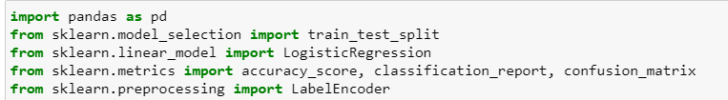
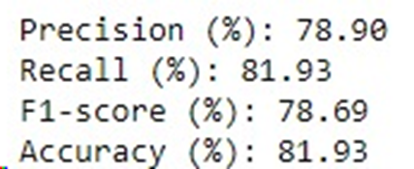
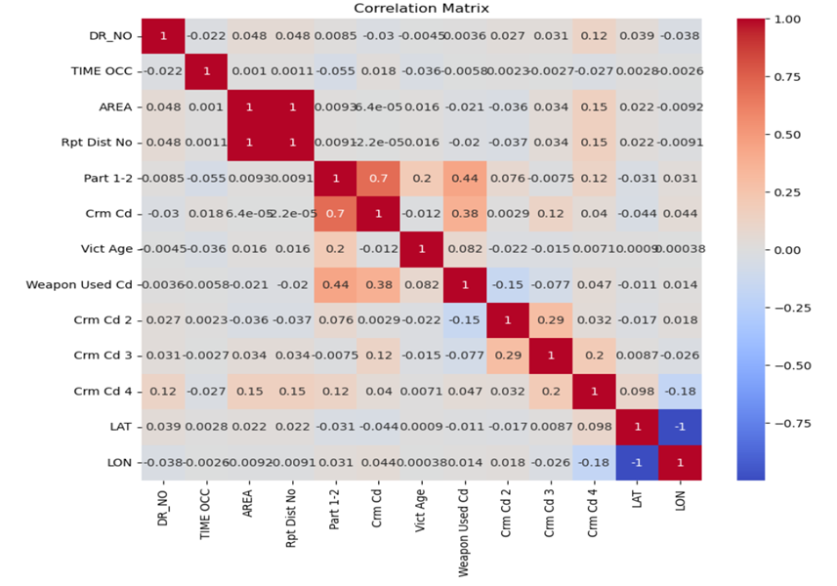
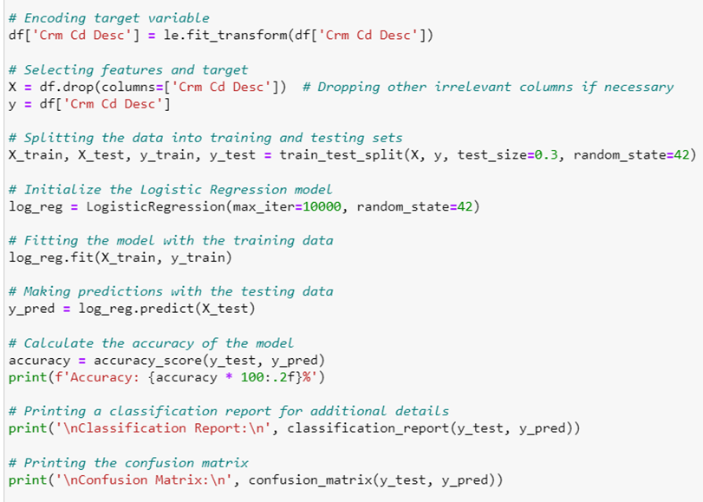
Logistic Regression
Imported Libraries
Test : Train = 30 : 70
Heatmap for Correlation Matrix
Logistic Regression Model for Crime Data

Slide 20
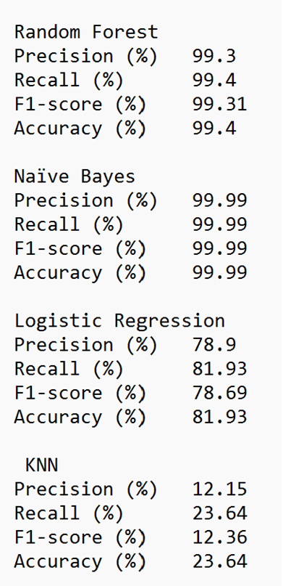
TESTING PHASE - Selection of MACHINE LEARNING MODEL
Why Random Forest Model?
Precision (99.3%): It shows that the model is correct 99.3% of the time when predicting crimes, which is crucial for efficient resource allocation.
Recall (99.4%): This indicates the model can identify 99.4% of actual crimes, ensuring public safety by minimizing missed events.
F1-Score (99.31%): The F1-score balances precision and recall, with a high value being important for a well-rounded crime prediction model.
Accuracy (99.4%):Boasting an exceptional 99.4% accuracy, the model showcases its impressive overall performance. To provide a well-rounded evaluation, it's important to take into account both precision and recall metrics.
Why Not ?
Naïve Bayes: Accuracy (99.99%): This indicates the overall rate at which the model correctly predicts crime. This suggests that Naïve Bayes performs exceptionally well but Naive Bayes assumes that all predictors (features) are independent of each other, which is rarely the case in real-world datasets like crime data.
Logistic Regression: Accuracy (81.93%): The accuracy is 91.93%, which means it's a decent model but not as performant as Random Forest. This model assumes a linear relationship between the independent variables and the log odds of the dependent variable, which might not hold true in the complex datasets for crime prediction.
NN Model: Accuracy (23.64%): The overall accuracy is low, which means the model is incorrect more than 75% of the time when predicting crimes.

Slide 21
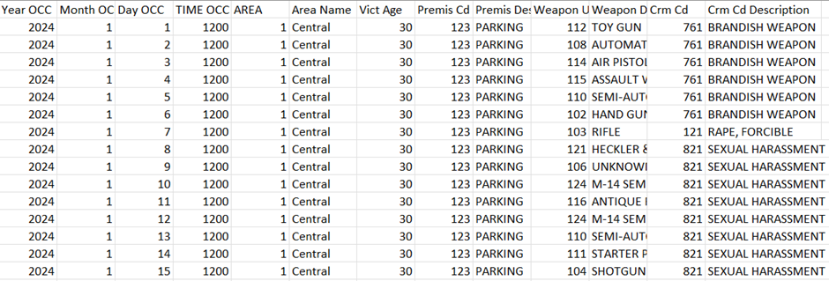
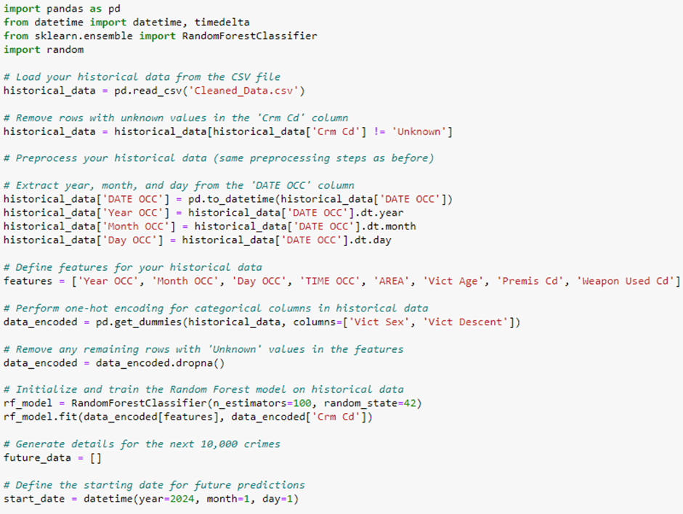
Generating Data For next 3 years with Random forest Model
Predictive Modeling of Crime Incidents Using Random Forest Classifier on Historical Data and Generating Future Crime Predictions

Slide 22
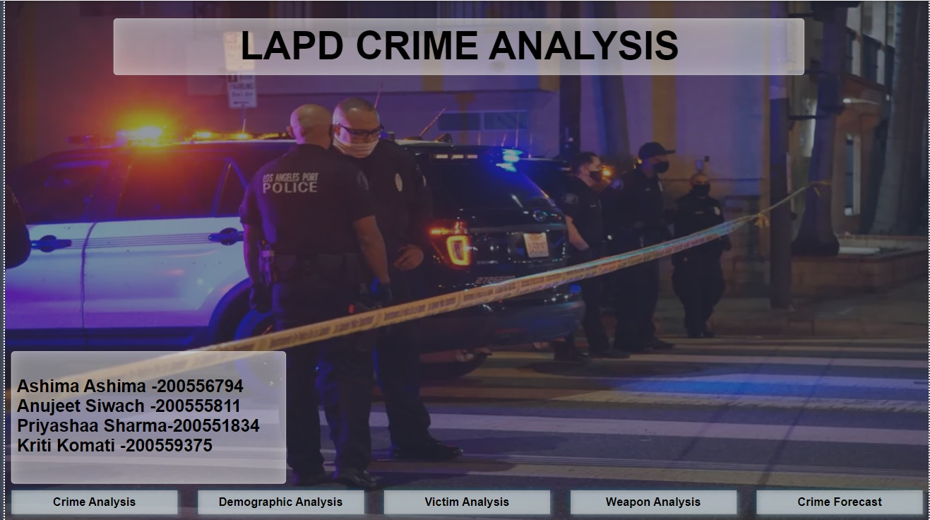
POWER BI DASHBOARDS

Slide 23
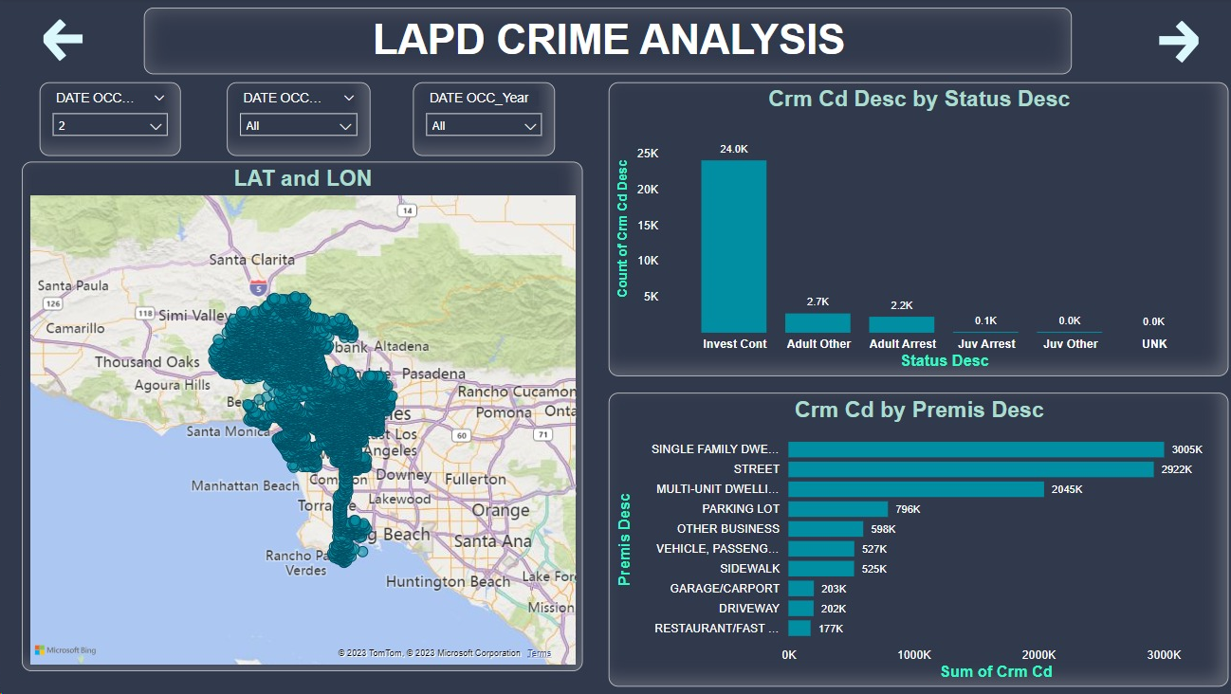
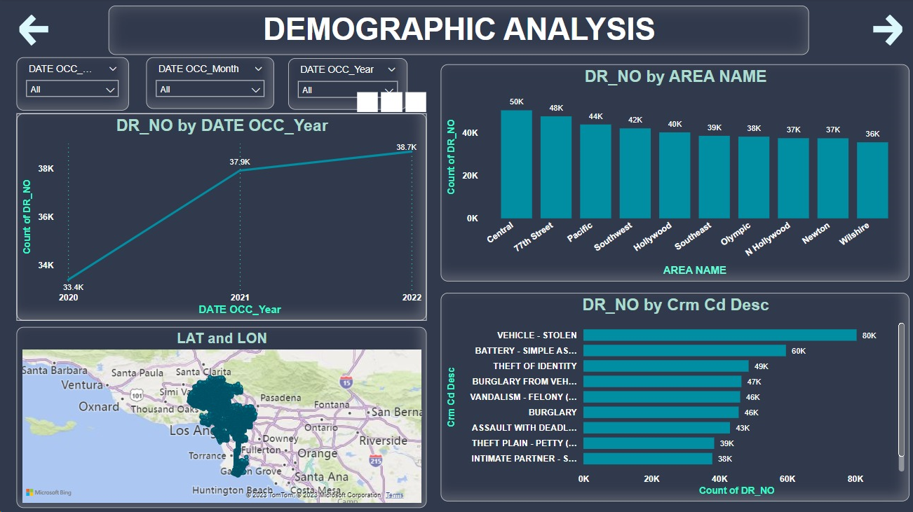
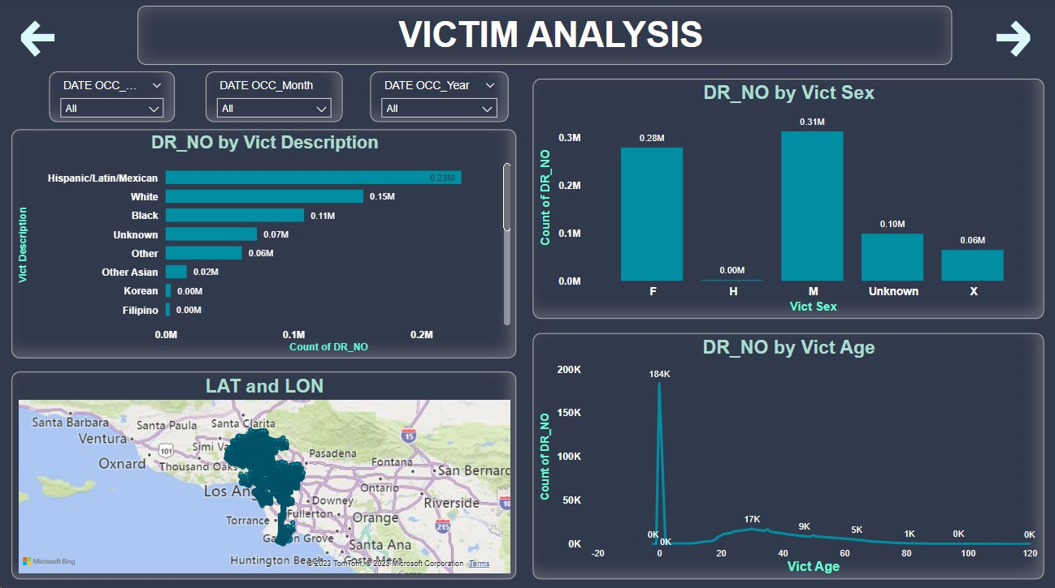
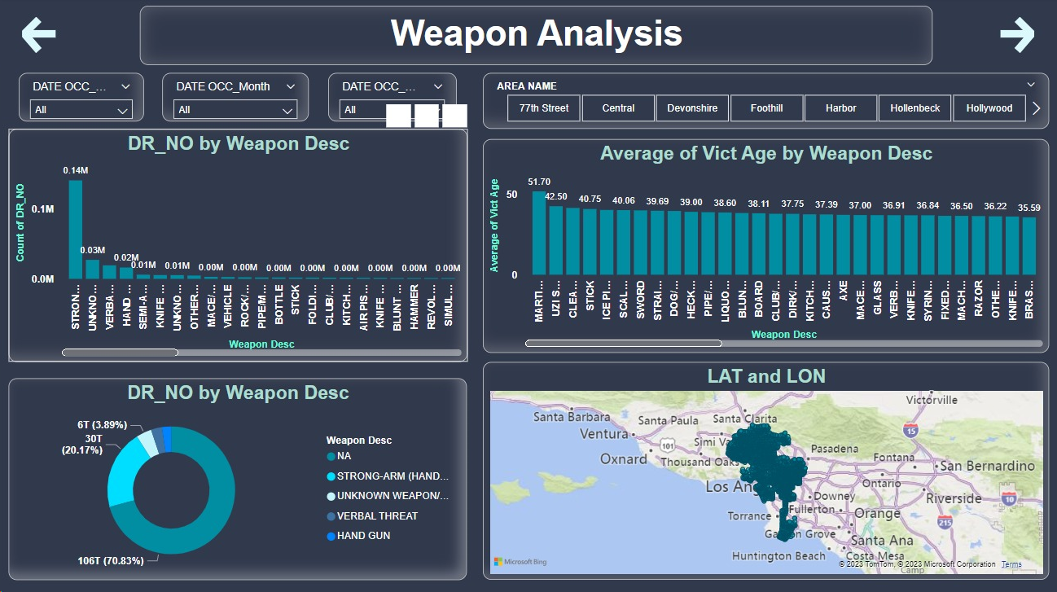

Slide 24
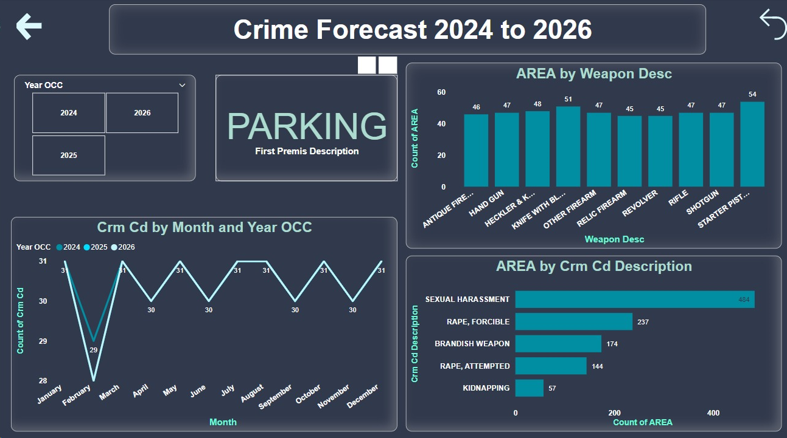
Add a Slide Title - 2

Slide 25
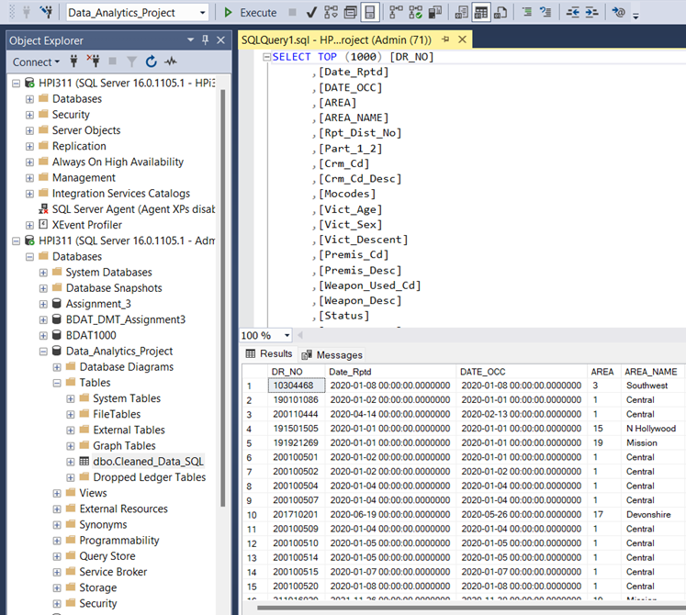
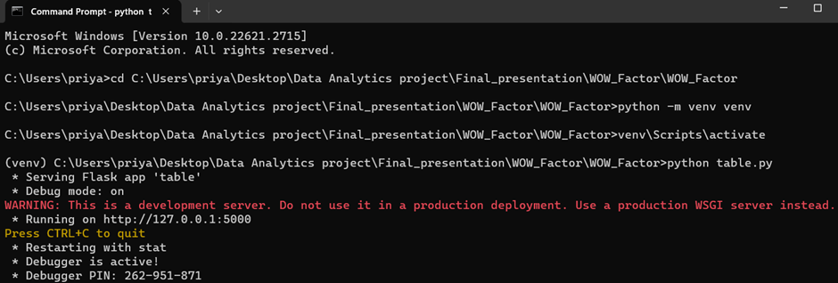
RELEASE PHASE - Hotspot identification using reactive web application

Slide 26


Hotspot identification using reactive web application

Slide 27





Geographical data and clustering of crimes

Slide 28

PROJECT COST
The project has been allocated a budget of $38,000, meticulously calculated to encompass all expenses, including personnel, materials, and unforeseen contingencies.
Strict adherence to this budget is imperative, with any deviations requiring prior approval.
Continuous monitoring and transparent reporting will be integral to maintain financial control, ensuring that the project remains within budget constraints.

Slide 29
RECOMMENDATIONS
Adopt Random Forest Models: LAPD should consider using Random Forest models for crime prediction due to their high accuracy and balanced precision-recall trade-off, enabling more effective resource allocation to high-risk areas.
Resource Allocation: With a precision rate of 99.3%, the Random Forest model empowers the LAPD to optimize resource allocation, targeting areas identified as high-risk by the model and proactively preventing crimes.
Targeted Interventions: Thanks to its high recall rate, the LAPD can utilize this model to enhance its coverage of actual crimes, facilitating strategic interventions in crime hotspots.
Evaluation and Adjustments:Regularly evaluate the effectiveness of strategies implemented based on the model’s predictions and adjust tactics as necessary to improve outcomes.

Slide 30
CONCLUSION
Concluding our work on leveraging predictive modeling to enhance crime prevention strategies, we have developed a robust approach using the Random Forest model. Our recommendations are designed to integrate seamlessly with this model's predictive capabilities, providing the LAPD with actionable insights for resource allocation, community engagement, and proactive policing.
The crime prediction webpage we've created serves as a central hub for data-driven decision-making. It offers real-time predictive insights, facilitates resource management, and fosters community collaboration. By adopting a multifaceted strategy that combines technology with human-centric approaches, the LAPD can address crime more effectively and build stronger and safer communities.

Slide 31
THANK YOU!

